Slide 1
ToDo
Previously: implementing automated global variable reinitialization for AFL++ persistent mode
Comparing fuzzing speed and crash detection ability of AFL++ normal mode and that of (manually configured) persistent mode
On programs with known crashes
Analyze the reason why fuzzing stability is too low for some programs
Does the reason is general or specific for each target program?

Slide 2
Comparing fuzzing speed and crash detection ability of AFL++ normal mode and that of (manually configured) persistent mode

Slide 3
Target Programs
Programs that need manual reinitialization for Persistent Mode (PM)
bison-3.7 (fails to apply persistent mode)
cflow-1.6
Building a control-flow graph from a given C source file
Persistent mode wrapping main possible with manual reinitialization
Manual Deferred Initialization (DI) before the first argv processing
Programs that do not need manual reinitialization for PM (just wrapping main without DI)
binutils/nm 2.36.1
binutils/size 2.36.1
exiv2 0.27.2

Slide 4
Manual Reinitialization for cflow
Clear variables in the global region
Clear argument file list
Prevent closing “stdout”

Slide 5
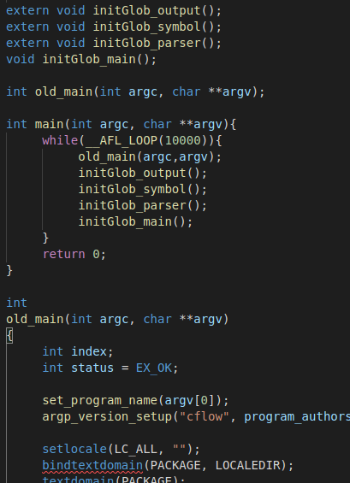
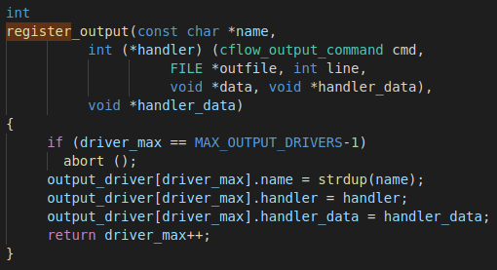
Manual Reinitialization for cflow
Clear variables in the global region
which can cause crash on persistent mode
Reinitialization functions for global variables in different files
Call the reinitialization functions at the end of the main function call
register output driver for each persistent mode iteration, which finally exceeds the MAX_OUTPUT_DRIVERS

Slide 6
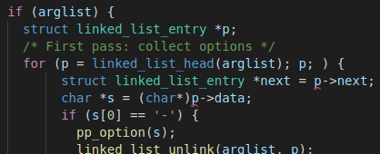
Manual Reinitialization for cflow
Clear argument file list
which stores the input files of previous runs unexpectedly
which does not cause crash but significantly increase execution time
arglist have input files of previous runs thus, program processes all the input files of previous runs

Slide 7
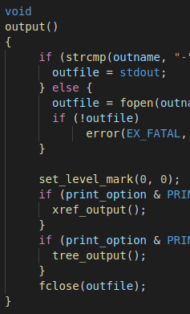
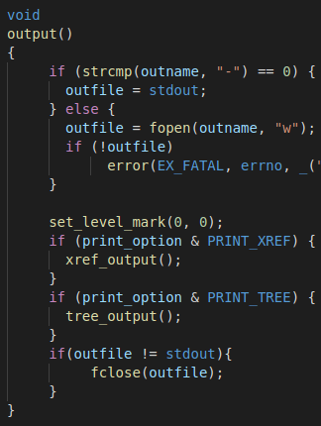
Manual Reinitialization for cflow
Prevent closing “stdout”
which does not cause crash
but, affects the program state outside the program memory space (e.g., file system)
Close outfile whether it is stdout or not thus, next run cannot use stdout

Slide 8
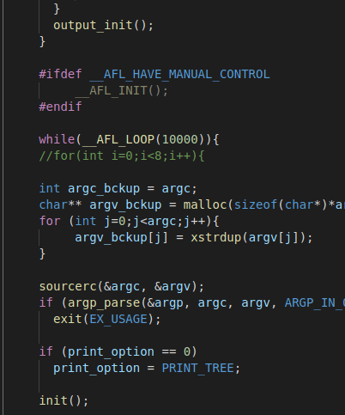
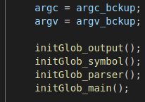
Manual Deferred Initialization
Initialize the target program instance just before the first argv processing
In the main function
Deferred initialization
Starting persistent mode loop after the deferred initialization
Manual state backup
(backup argc and argv because cflow modify argc and argv)
First argv processing point
…
Manual state reset at the end of the persistent loop

Slide 9
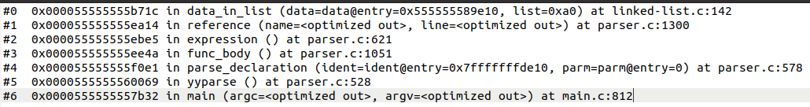
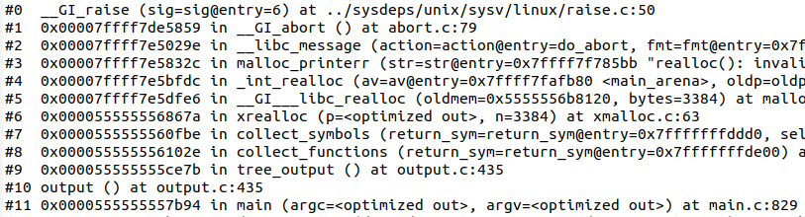
Results
Speed-up when using PM but, worse crash detection ability
cflow-1.6 | exec/sec | bitmap_cvg | stability | saved crashes (reproducible)
Normal | 2437.59 | 21.58% | 100.00% | 189
PM | 10985.00 | 22.54% | 21.94% | 207 (199)
DI | 2946.05 | 22.14% | 100.00% | 217
DI+PM | 12335.84 | 21.55% | 21.23% | 181 (138)
188 known crashes and 1 new crash
All the known crashes
215 known crashes and 2 new crashes
All the known crashes
An example stack trace of the known crash
Too low stability which causes not-reproducible crash inputs
Need more exhaustive reinitialization?
Stack trace of the new crash

Slide 10

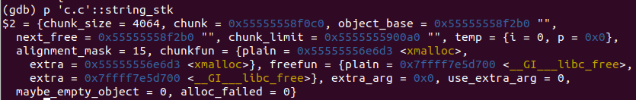
Exhaustive Reinitialization
Reinitialize all global variables that are changed after a run
Make a list of
Global Variables (GV)
GV list
For each GV in the list
Run gdb
Target program
A seed input
Extract the value
of the GV at the beginning
Extract the value
of the GV at the end
GV value
at the beginning
GV value
at the end
If they are different,
GV list to reinitialize
GV
‘c.c’::string_stk at the beginning
‘c.c’::string_stk at the end

Slide 11
Results with Exhaustive Reinit.
Slightly increased stability, but significant slow down and worse crash detection ability
cflow-1.6 | exec/sec | bitmap_cvg | stability | saved crashes (reproducible)
Normal | 2437.59 | 21.58% | 100.00% | 189
PM | 10985.00 | 22.54% | 21.94% | 207 (199)
PM (ExReinit) | 3703.74 | 22.55% | 31.79% | 183 (179)
188 known crashes and 1 new crash
All the known crashes
All the known crashes

Slide 12
Result Summary of the Four Target Programs
cflow-1.6 | exec/sec | bitmap_cvg | stability | saved crashes
Normal | 2437.59 | 21.58% | 100.00% | 189
PM | 10985.00 | 22.54% | 21.94% | 207 (199)
DI | 2946.05 | 22.14% | 100.00% | 217
DI+PM | 12335.84 | 21.55% | 21.23% | 181 (138)
Two distinguished crashes
Same crashes
Two distinguished crashes
Same crashes
binutils2.36.1/nm | exec/sec | bitmap_cvg | stability | saved crashes
Normal | 480.43 | 3.80% | 100.00% | 0
PM | 461.51 | 3.81% | 100.00% | 0
binutils2.36.1/size | exec/sec | bitmap_cvg | stability | saved crashes
Normal | 417.38 | 2.95% | 100.00% | 7
PM | 991.31 | 3.14% | 99.49% | 10
Same crashes
(none of them is the known one)
Three distinguished crashes
(none of them is the known one)
exiv2 0.27.2 | exec/sec | bitmap_cvg | stability | saved crashes
Normal | 2619 | 7.92% | 100.00% | 0
PM | 8545 | 8.22% | 99.20% | 0
Let’s find the reason for the low stability!

Slide 13
Analyze the reason why fuzzing stability is too low for some programs
(Does the reason is general or specific for each target program?)

Slide 14
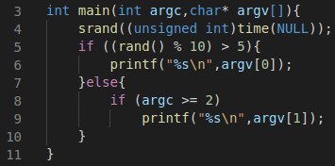
AFL++’s Stability
(# of found edges - # of edges variable) / # of found edges
$ ex aa
(random number >5)
$ ex aa
(random number <=5)
ex.c
edges | hit count
3→5 | 1
5→6 | 1
5→8 | 0
8→9 | 0
8→10 | 0
edges | hit count
3→5 | 2
5→6 | 1
5→8 | 1
8→9 | 1
8→10 | 0
edges
found
edges
variable
Unstable due to the randomness
Stability = (4-3)/4=25%

Slide 15
Analysis for Reasons of Low Stability
Edge IDs and
corresponding functions
Extract
edge IDs
Target program
Extract functions
of var. edges
Functions of var. edges
afl-fuzz
with debug mode
Variable (var.) edges
A seed input
Count edge hit
of each function
edge hit count
of run 1
edge hit count
of run 2
…
edge hit count
of run x
Compare!

Slide 16
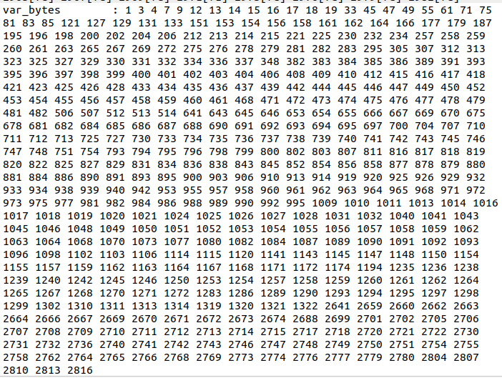
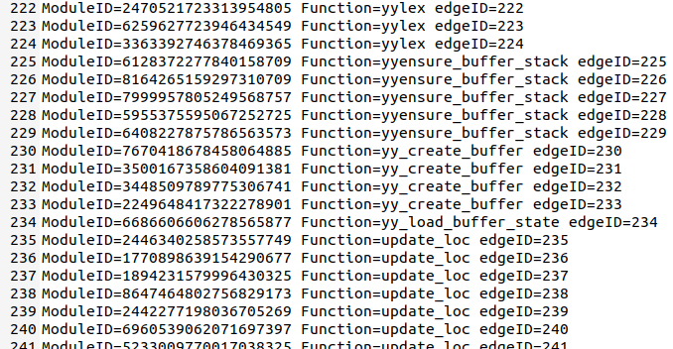
Extract Edge IDs and Var. Edges
Using AFL++ lto mode compiler and afl-fuzz debug mode
Corresponding functions
of each edge
Unique edge ID
Edge IDs of cflow extracted by afl-clang-lto at compile time
Var. edge IDs of cflow extracted by afl-fuzz debug mode
(30 seconds of fuzzing run)

Slide 17
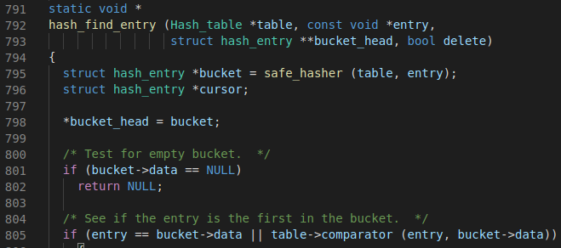
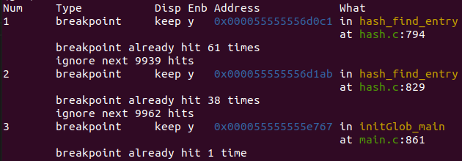

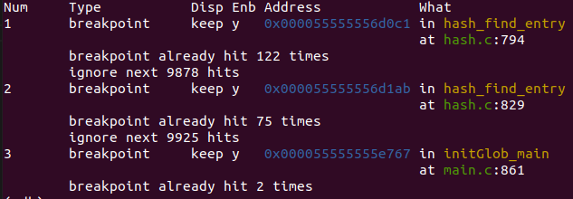
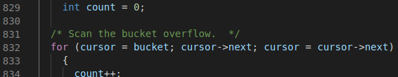
Count Edge Hit of Each Function
Same number of the function call across the two runs
edge hit count of run 1 for the function hash_find_entry
…
122-61=61
75-38=37
edge hit count of run 2 for the function hash_find_entry
Different number of edge hit across the two runs

Slide 18
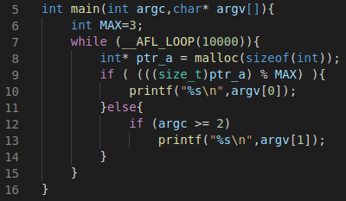
A Found Reason for the Instability
Use an outside (out of process) factor which is affected across inputs
e.g., file system access, system call
$ ex aa
$ ex aa
ex.c
edges | hit count
8→9 | 1
9→10 | 0
9→12 | 1
12→13 | 1
12→14 | 0
edges | hit count
8→9 | 2
9→10 | 1
9→12 | 1
12→13 | 1
12→14 | 0
edges
found
edges
variable
Unstable due
to system call
(general for most of
target programs)
heap
heap
0x000F
0x000B
0x0007
0x0003
0x000F
0x000B
0x0007
0x0003
ptr_a
ptr_a

Slide 19
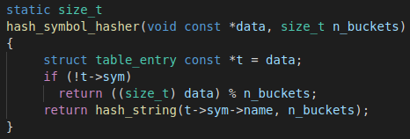
A Found Reason for the Instability in cflow
Hash function that uses memory address as key
Unstable, but correct
Use memory address (which may vary across inputs) of a pointer variable data as the key for hash

Slide 20
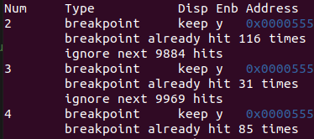
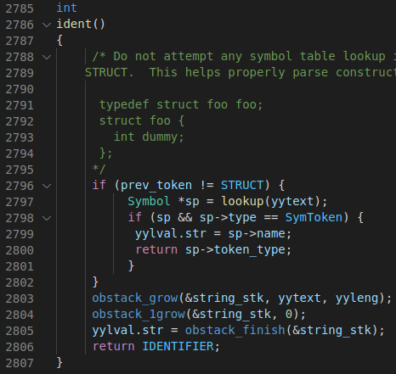
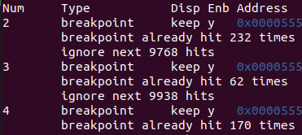
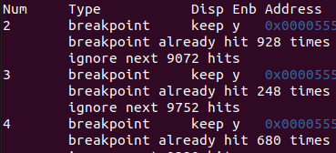
There may be More Reasons of Low Stability, but
Difficulty on finding the reasons
Some variable edges occur after many side effects of many fuzzing inputs
and hard to catch the time it occur.
Run 1
b2
b3
232=116*2
Run 2
62=31*2
b4
170=85*2
The function ident that includes var. edges
…
No found var. edges
across eight runs
928=116*8
Run 8
248=31*8
680=85*8

Slide 21
There may be More Reasons of Low Stability, but
Difficulty on finding the reasons
Still some global variables are not reinitialized after the exhaustive reinitialization.
Make a list of
Global Variables (GV)
GV list
For each GV in the list
Run gdb
Target program
A seed input
Extract the value
of the GV at the beginning
Extract the value
of the GV at the end
GV value
at the beginning
GV value
at the end
If an input changes,
GV list to reinitialize also changes.
If they are different,
GV list to reinitialize
GV

Slide 22
Next ToDo
Analyze the reason why fuzzing stability is too low for some programs
Does the reason is general or specific for each target program?
Analyze the reasons for the instability of cflow and bison
NOTE: after exhaustive global var. reinitialization, persistent mode for bison still fails for all seed inputs
By excluding unstable-but-correct functions (files) from instrumentation
By repeating 1. finds a variable input, 2. finds the GV list to reinit. for the variable input, 3. reinitialize the GVs
Make 100% stability of binutils/nm and exiv2

